Slide 1

COMP8011
Advanced Database Systems
Session 02
Data Warehouse Components
This presentation is based on Michael A. Fudge, Jr.

Slide 2
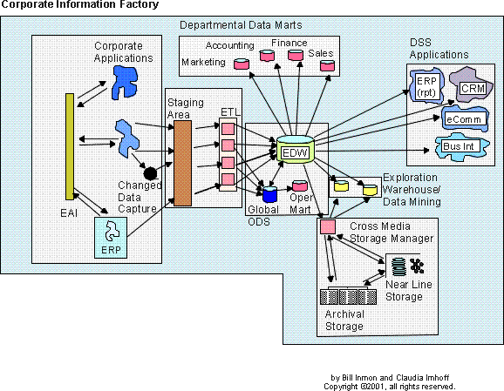
Inmon’s Corporate Information Factory (CIF)
The CIF is a
reference architecture
Notes:
As you may recall from our previous unit, data warehousing exists because the structure of our business data is not suitable for reporting – especially long-term trends. Therefore we need to “re-shape” our data to suit the reporting needs of the organization.
Inmon’s corporate information factory is a reference architecture for “data warehousing” it explains the systems and components required to “do” data warehousing.
One thing that might be confusing to you at this point is that the data warehouse is the tiny cylinder is the center of the picture.
Think of the term “data warehousing” as the overall activity… collecting, extracting, re-shaping data, then storing it for reporting and analytic purposes. One of the key cogs in this process is the “Enterprise Data warehouse” as described by Inmon. So to me “data warehousing” is represented by all the components you see in this picture, with the Enterprise Data warehouse being one of those components.

Slide 3
Understanding the Diagram
Data Stores
Applications
Components
Processes
The CIF is a
reference architecture
Notes:
Big white boxes – main components
Funny shapes represent applications
Cylinders are data stores – typically in a RDBMS ( Oracle, Sybase, SQL Server) or MOLAP ( Oracle Essbase, IBM Cognos, MS Analysis Services)
Boxes represent processes or programs.

Slide 4
External World & Applications
The CIF is a
reference architecture
Notes:
First we’ll look at the external world and applications – highlighted in yellow

Slide 5
External World & Applications
External World – the people and systems that generate operational data.
Applications – the systems which provide the source for the operational data.
Examples: ERP’s, Business Applications, Internet data, external data streams.
These are the inputs and data sources for the CIF.
OLTP Systems – Operational data, transaction-oriented.

Slide 6
Integration & Transformation Layer
The CIF is a
reference architecture
Notes:
Next we look at the integration and transformation layer

Slide 7
Integration & Transformation Layer
I&T layer – takes un-integrated data from multiple sources and integrates and consolidates it.
Computer programs are written to transform data from the external world into corporate data.
The data come from a variety of sources and in both structured and un-structured formats.
Today’s Database Management Systems provide tooling to assist with this process.
This is the most difficult and time-consuming component of the CIF.
Two approaches: ETL and ELT
Notes:
We’ll use SQL Server Analysis Services
There are two main approaches to data processing in the integration and transformation layer.
1) ETL and 2) ELT

Slide 8
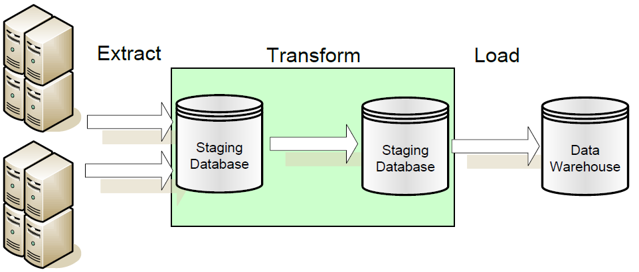
ETL – Extract Transform Load
The data transformation occurs over staged data.
The source data is not stored in the warehouse.
Notes:
To the left are your external world applications.

Slide 9
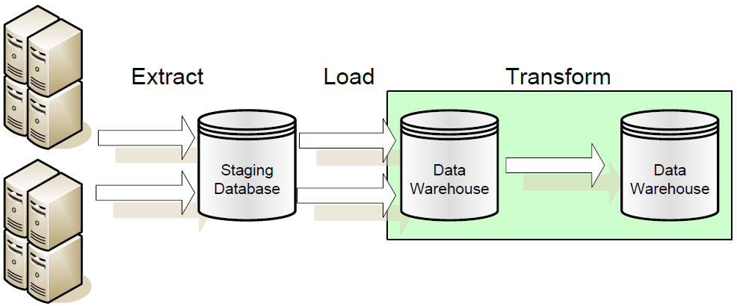
ELT – Extract Load Transform
The data transformation occurs over warehoused data.
The staged data is stored in the warehouse.
Notes:
In ETL you’re not storing pre-transformed data. In ELT you are. The approach you’ll use depends on the cost of transforming the data and the usefulness of the source extract in application of the data warehouse.
For example if you’d want to implement “drill through” to a specific order it might be useful to have the official source extract as a reference.
This situation as a special component of its own, which is the subject of our next slide….

Slide 10
Operational Data Store
The CIF is a
reference architecture

Slide 11
Operational Data Store
Integrated, detailed, and current data from the External World and Applications.
Consolidated from disparate sources.
Does not grow over time.
Performs similarly to a transactional database.
Structured differently than a data warehouse, and therefore should be stored as a separate database.
Receives data from I&T layer sends data to the data warehouse.
The data warehouse can populate it, too.
Think of it as a consolidated operational database.
Notes:
More on this in a bit but first.

Slide 12
Enterprise Data Warehouse
The CIF is a
reference architecture

Slide 13
Enterprise Data Warehouse
Subject-oriented, integrated, summarized, and current data from the External World and Applications.
Optimized for query performance.
Structured differently than operational data, typically in a dimensional model.
Receives data from I&T layer and the ODS.
Use as a source for data marts and decision support systems.
Grows in size over time due to historical data.
The heart of the CIF.

Slide 14
ODS vs. EDW
Characteristic | Operational Data Store | Data Warehouse
Primary Purpose | Run the business on a current basis | Support managerial decision making
Design Goal | Performance throughput, availability | Easy reporting and analytics
Primary Users | Clerks, salespersons, administrators | Managers, business analysis, customers
Subject-Oriented | Yes | Yes
Integrated | Yes | Yes
Detailed Data | Yes | Yes
Summary Data | No | Yes
Time of Data | Current data | Historical snapshots
Updates | Frequent small updates | Periodic batch updates
Queries | Simple queries on a few rows | Complex queries on several rows

Slide 15

Why No ODS in the EDW?
I need fast updates!
I need query performance!
You can’t have both! (Think of the Index!)
Notes:
At the heart of the ODS and EDW debate is that they serve different needs. Talk to any database administrator and they’ll tell you one cannot tune the same database to support both fast queries and fast updates. It’s one or the other.
This is the rational behind the ODS. We put the data which requires updates and changes in our ODS system, and the typically static bulk-loaded read-only DW data in the EDW.
That way both systems can be configured to perform their intended function to the best of their capability.

Slide 16
Data Marts
The CIF is a
reference architecture

Slide 17
Data Marts
A collection of data tailored to the informational needs of a department or business process.
Easy to control, low cost, and customizable due to their limited scope.
Receive their inputs from the Enterprise Data Warehouse.
Are source data for Online Analytical Processing (OLAP) engines.

Slide 18
OLAP
ROLAP
MOLAP
Uses a Relational Database Management System
Data design is the Star Schema
Built on well-known relational concepts
In the EDW.
Uses a Multi-Dimensional Database Management System
Data design is the Cube
Highly flexible, includes Metadata.
Data Marts
Typical implementations have the
ROLAP star schema feed the MOLAP cube

Slide 19
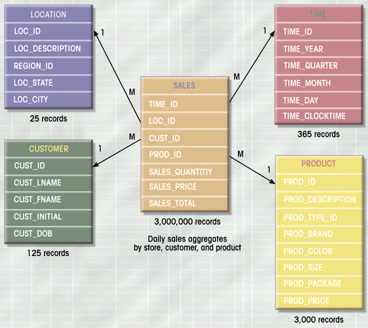
ROLAP – Star Schema
Stored in a relational DBMS
Fact table is M-M relationship among dimensions.

Slide 20
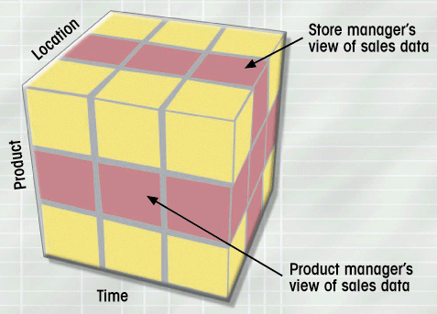
MOLAP - Cube
Stored in a Multi-Dimensional DBMS
Facts are pre-aggregated across all dimensions for improved performance.
Metadata: Drill down hierarchy and Identified Facts

Slide 21
DSS Applications
The CIF is a
reference architecture

Slide 22
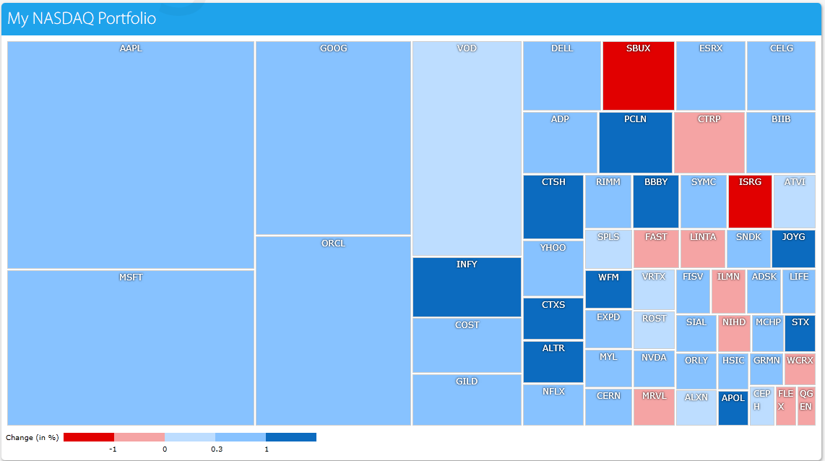
Decision-Support Systems
Business Intelligence.
Front-ends to ROLAP and MOLAP Engines.
Help us explore and visualize information at a high level

Slide 23
Cross-Media Storage
The CIF is a
reference architecture

Slide 24
Cross-Media Storage Manager
Stores historical data which is infrequently accessed.
Moved out of the EDW, which has high-end, performant storage into more affordable storage with less performant access times.
A process exists to enable some transparency in the retrieval process.

Slide 25
Generic DW Architectures
Three-tier architecture
Data acquisition software (back-end)
The data warehouse that contains the data & software
Client (front-end) software that allows users to access and analyze data from the warehouse
Two-tier architecture
First 2 tiers in three-tier architecture is combined into one
… sometime there is only one tier?

Slide 26
Generic DW Architectures
3-tier
architecture
2-tier
architecture
1-tier
Architecture
?

Slide 27
A Web-based DW Architecture

Slide 28
Independent Data Marts
Data marts that are independent of each other
Often created by organization units
Inconsistent data definitions and different dimensions and measures

Slide 29
Data Mart Bus Architecture
Creation starts with a business requirements analysis for a specific process such as orders, deliveries, customer calls, or billing.
One mart is created for a single business process
Additional marts are developed using the conformed dimensions of the first mart

Slide 30
Hub-and-Spoke
Developed after an enterprise-level analysis of data requirements
Focused on building a scalable and maintainable infrastructure
Developed in an iterative manner
Dependent data marts obtain the data from the warehouse
Consist of a centralized hub that accepts requests from multiple applications that are connected through spokes

Slide 31
Centralized Data Warehouse
Similar to the hub-and-spoke architecture except there are no dependent data marts
Contains atomic-level data, some summarized data, and logical dimensional view of the data
Queries and applications access data

Slide 32
Federated Architecture
Leaves existing decision-support structures in place
Shares information among a number of different systems
Data is either logically or physically integrated
Shared keys
Global metadata
Distributed queries

Slide 33
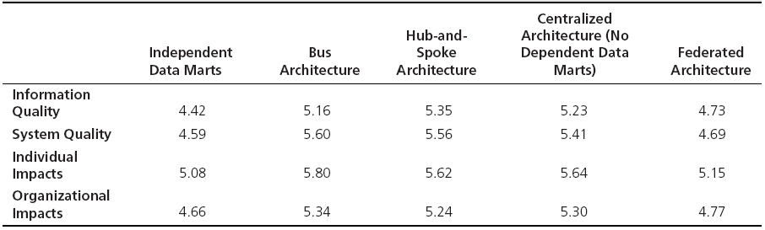
Which Architecture is the Best?
Bill Inmon versus Ralph Kimball
Enterprise DW versus Data Marts approach
Empirical study by Ariyachandra and Watson (2006)

Slide 34
Data Warehousing Architectures
Ten factors that potentially affect the architecture selection decision:
Urgency of need for a data warehouse
Upper management’s information needs
Nature of end-user tasks
Information interdependence between organizational units
Constraints on resources
Perceived ability of the in-house IT staff
Strategic view of the data warehouse prior to implementation
Compatibility with existing systems
Technical issues
Social/political factors

